Slide 1

UNH SEDS
Senior Design Project
2018-2019

Slide 2
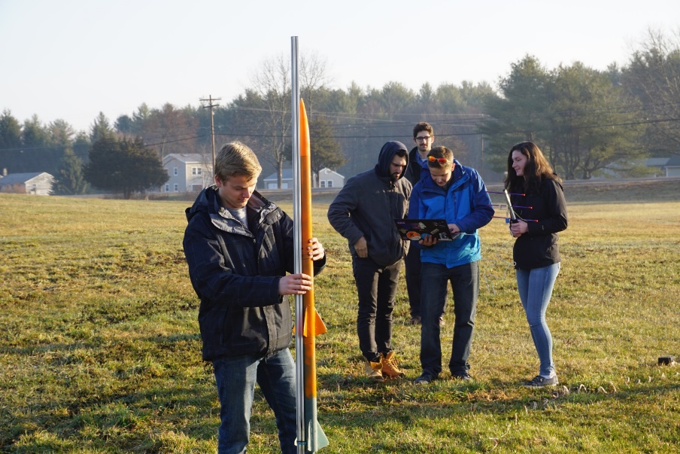
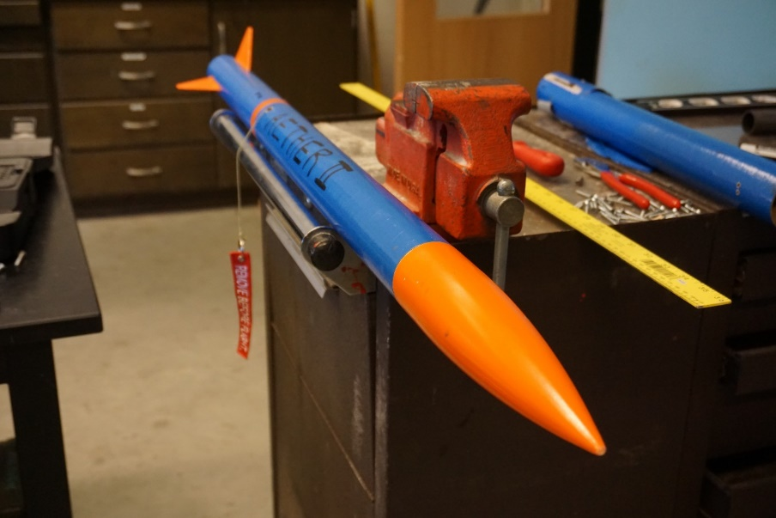
What is UNH SEDS?
Students for the Exploration and Development of Space (SEDS) is a non-profit that empowers young people to participate and make an impact in space exploration. SEDS helps students develop their technical and leadership skills by providing opportunities to manage and participate in national projects as well as to attend conferences.
We are an interdisciplinary rocketry organization founded in 2017 that has members from 6 different majors and every class.

Slide 3
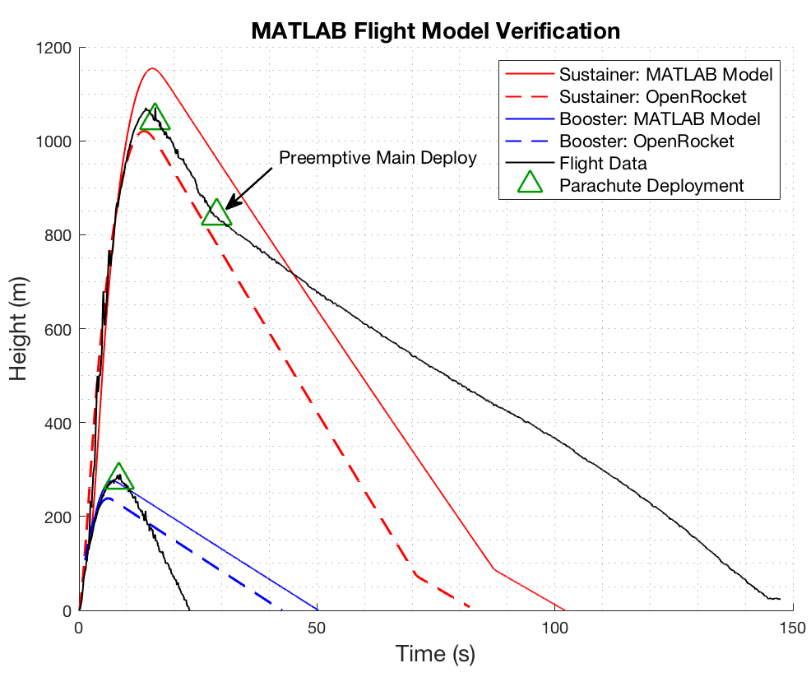
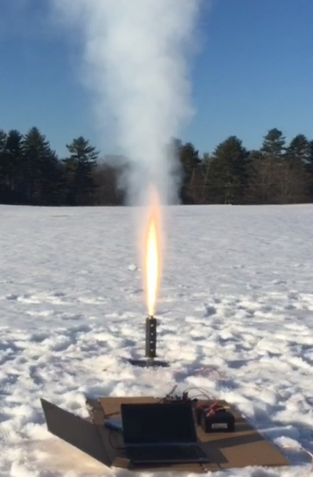
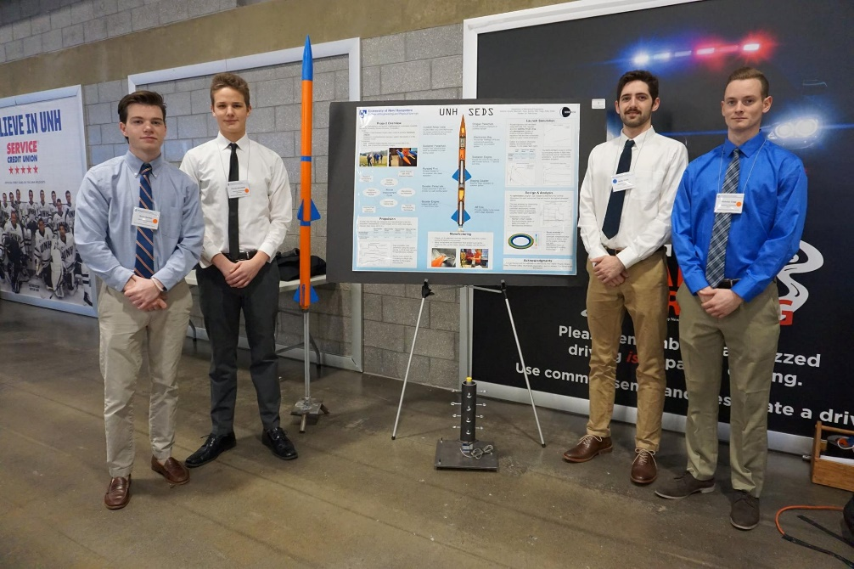
What Have We Done?
Worked on increasing our ‘Body of Knowledge’ in rocketry building techniques by building and launching eight rockets in a local field nearby, each one performing better then the last
Created and optimized launch simulations to accurately predict the flight path of each rocket flown
Used MATLAB to optimize rocket dimensions to maximized altitude reached
Measured thrust of our engines using a static test fire rig to more accurately predict the flight path of our rocket
Placed second place at the URC in the mechanical engineering competition teams
Currently at work in participating in the University Student Rocketry Competition in October 2018

Slide 4
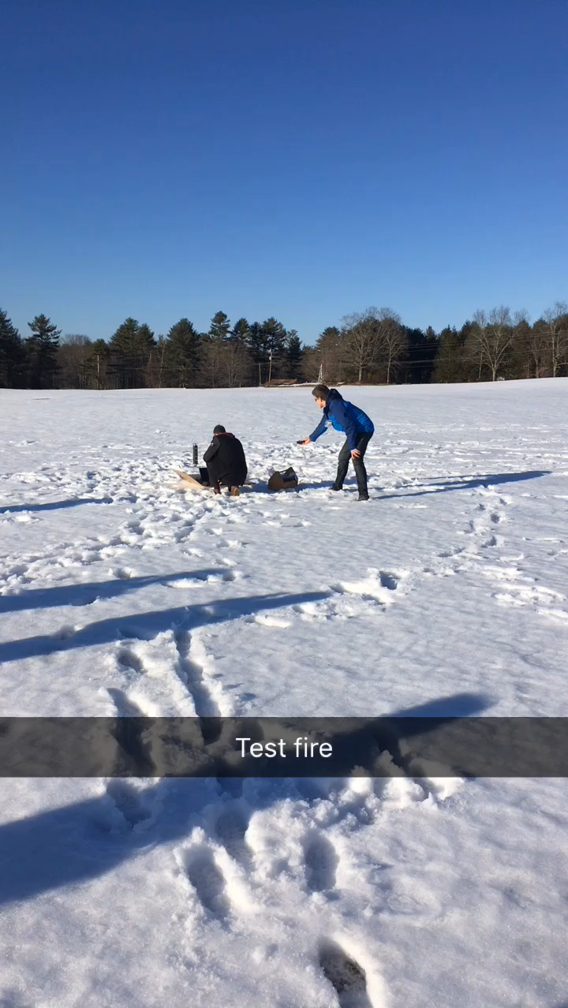
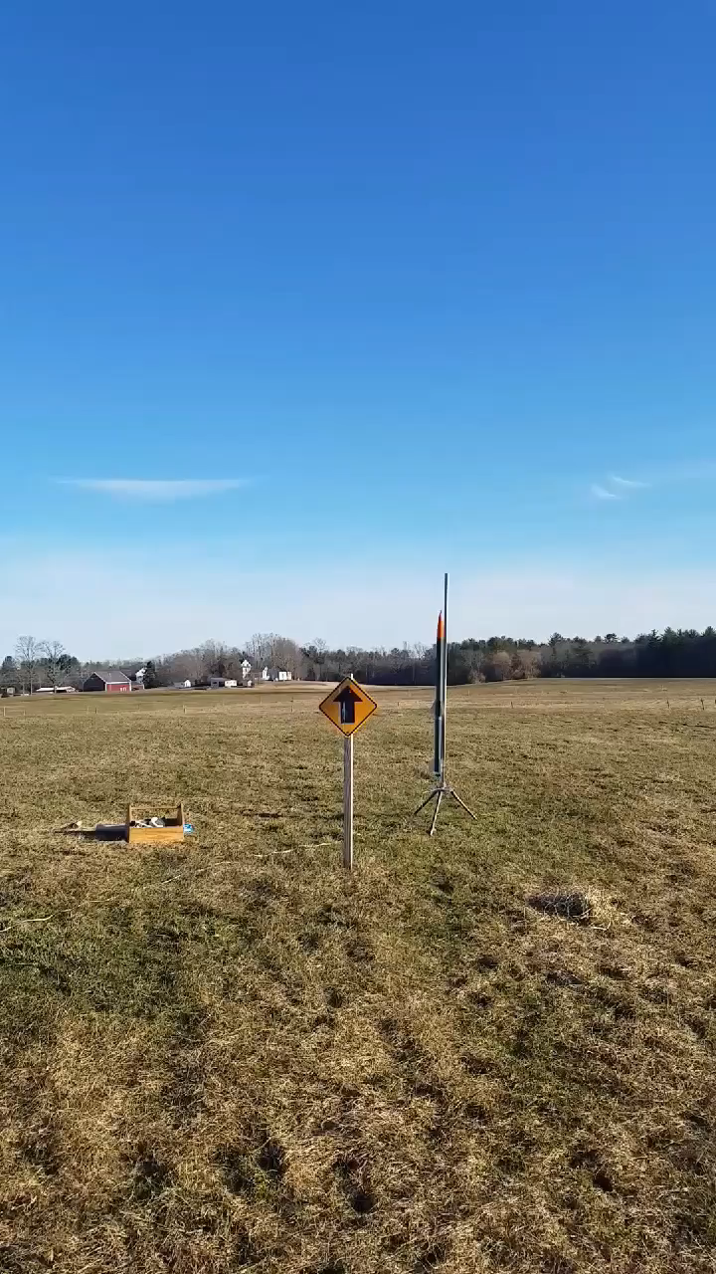
Some Videos…
Our static test fire for our competition booster engine
Our first successful multistage rocket

Slide 5
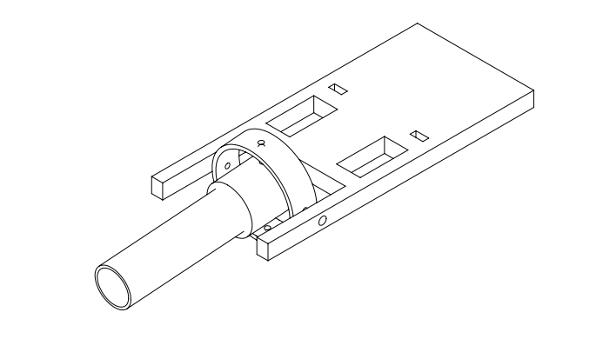

Goals for UNH SEDS 2018-2019
Finish participation in the University Student Rocketry Competition
An incorporated hybrid rocket engine with gimbal assembly
Compete in SpacePort America Cup
Gimbaled Hybrid Engine, carbon fiber body
Flight control on-board, control thrust and all events (drogue and landing)

Slide 6
Senior Design Project
Searching for 4-5 Senior Mechanical Engineering majors to assist in all aspects of UNH SEDS which primarily includes:
The design and manufacturing of a hybrid rocket engine with an integrated guidance system
Major testing and optimization needed through the year to achieve a nominal hybrid engine
The design and manufacturing of a payload to be deployed at apogee to do a function that collects data
Compete in the Spaceport America Cup in June 2019.
Also a huge networking event where recruiters from around the world come including NASA, SpaceX and Blue Origin

Slide 7
Spaceport America Cup Video
https://www.youtube.com/watch?time_continue=2&v=lTKRDd1ovAs

Slide 8
What else?
We will also have two EE senior project and a CS senior project to help lead the electronics and code needed for the projects. They will also be doing various other projects that can be integrated into our rocket through time.
We will present in the URC 2019 in the mechanical engineering competition team bracket and the EE and CS seniors will present in their own respectively.
SEDS USA hosts a national conference every year called SpaceVision where many of the various SEDS chapters congregates to network and listen to speakers. This year, it is in November 2018 in California.
This isn’t just a senior project, but joining a family that participates in outreach events and networking with nearby SEDS chapters. Senior Project Member prospects must be down to participate in all aspects of what UNH SEDS does

Slide 9
Questions?

